Slide 1
Outline of Today’s Discussion
Introduction to Multiple Regression
Hierarchical & Stepwise Multiple Regression
Practice: MR Examples & Student Interests
Why does order of entry matter?
Simultaneous (Standard) Multiple Regression
Partial Correlation

Slide 2
Part 1
Introduction To
Multiple Regression

Slide 3
Multiple Regression
So far, we’ve attempted to use regression for prediction.
Specifically, we’ve tried to predict one variable Y (called the criterion), using one other variable (called the predictor).
Multiple Regression - the process by which one variable Y (called the criterion) is predicted on the basis of more than one variable (say, X1, X2, X3…).

Slide 4
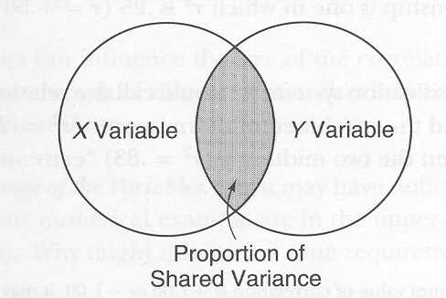
Multiple Regression
Here’s the simple case of one predictor variable.
The overlap (in gray) indicates the predictive strength.

Slide 5
Multiple Regression
If the overlap in the Venn diagram were to grow,
the r-value would grow, too!

Slide 6
Multiple Regression
Variable X₁
Criterion (Y)
Here’s the same thing again…
but we’ll call the the predictor variable X₁.

Slide 7
Multiple Regression
Variable X₂
Variable X₁
Criterion (Y)
By adding another predictor variable X₂,
we could sharpen our predictions. Why?

Slide 8
Multiple Regression
Variable X₂
Variable X₁
Criterion (Y)
Unfortunately, X₁ and X₂ provide some redundant
information about Y, so the predictive increase is small.

Slide 9
Multiple Regression
Variable X₂
Variable X₁
Criterion (Y)
Unfortunately, X₁ and X₂ provide some redundant
information about Y, so the predictive increase is small.

Slide 10
Multiple Regression
Variable X₂
Variable X₃
Variable X₁
Criterion (Y)
By contrast, variable X₃ has no overlap with either
X₁ or X₂, so it would add the most new information.

Slide 11
Multiple Regression
Variable X₂
Variable X₃
Variable X₁
Criterion (Y)
In short, since all three predictors provide some unique
information, predictions w/b best when using all three.

Slide 12
Multiple Regression
Variable X₂
Variable X₃
Variable X₁
Criterion (Y)
If you wanted to be more parsimonious and use only
two of the three, which two would you pick, and why?

Slide 13
A Brief Review of Multiple Regression
Predicting scores on a criterion variable from two or more predictor variables
Overall accuracy of a prediction rule is called the proportion of variance accounted for, and is abbreviated as R².

Slide 14
Hierarchical versus Stepwise Multiple Regression
Part 2

Slide 15
Hierarchical Multiple Regression
Albert Einstein
The Power of a Theory
Without theories, psychology could be reduced to
cataloging stimulus-response pairs, infinitely.

Slide 16
Stepwise Multiple Regression
Sir Isaac Newton
"Hypothesis non fingo"
"I do not feign a hypothesis"
Newton's response when asked about what constitutes space

Slide 17
Hierarchical and Stepwise Multiple Regression
Hierarchical multiple regression
Predictor variables are entered into the regression sequentially, and the order depends on your theory.
Stepwise multiple regression
Computer selects predictor variable that accounts for most variance on the criterion variable, if significant
Process repeats by selecting variable that accounts for the most additional variance, if significant, and so on
Used as an exploratory technique; is controversial

Slide 18
Hierarchical vs. Stepwise Multiple Regression
Both involve adding variables sequentially and checking for significant improvement in the degree to which the model can predict scores on the criterion variable.
In hierarchical multiple regression, the order is determined in advance, by a theory or plan
In stepwise multiple regression, order is determined by a computer
Note: For a given data set…these two procedures could generate DIFFERENT regression equations!

Slide 19
Hierarchical vs. Stepwise Multiple Regression
When do we use which?
IT DEPENDS!
Here are some considerations…

Slide 20
Hierarchical vs. Stepwise Multiple Regression
Hierarchical Regression – Good for testing a theory!
Stepwise Regression – Good for exploring data sets!

Slide 21
Hierarchical vs. Stepwise Multiple Regression
Hierarchical Regression – you add variables in planned sequence and continue to the end regardless of whether “earlier” variables are significant or not. No stopping until all your theory’s variables are in!
Stepwise Regression – a computer adds predictors successively according to which turns out to be the best additional predictor among the remaining variables. You stop when the best remaining predictor is non-significant.

Slide 22
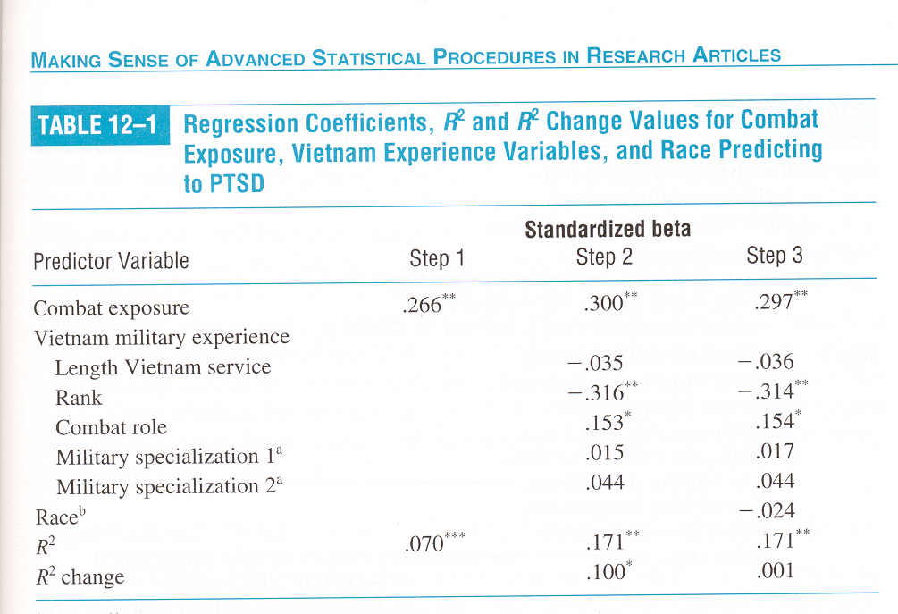
Hierarchical vs. Stepwise Multiple Regression
Hierarchical Regression – Predicting PTSD

Slide 23
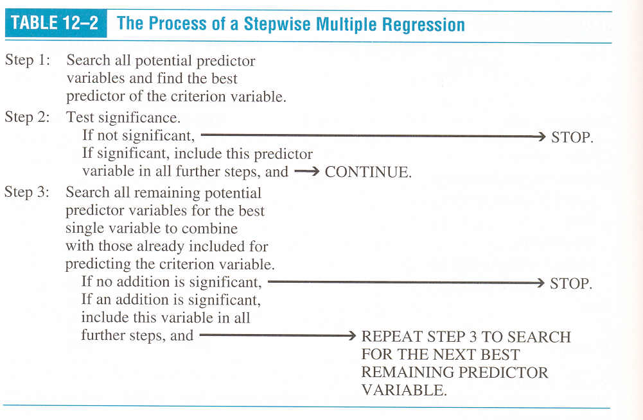
Hierarchical vs. Stepwise Multiple Regression
Stepwise Regression – Good for Data Exploration!

Slide 24
Hierarchical vs. Stepwise Multiple Regression
Stepwise MR can be useful for APPLIED researchers or THERAPISTS…
“I don’t care about theories…I just want to be able to predict who will benefit from my treatment (perhaps ECT) and who will not”
Hypotheses non fingo…big time!
Stepwise MR is controversial though…

Slide 25
Hierarchical vs. Stepwise Multiple Regression
Let’s say that two predictors, “M” and “J”, have equal predictive power…in the population.
For a particular sample, “M” might turn up just barely above statistical significance, and “J” is just barely below significance.
Here, “M” would be selected and “J” excluded.
But a different sample could well have generated the reverse!
There’s a difference between “M” being significantly better than “J”, and “M” being significantly better than zero (“Chance”) but not significantly better than “J”…

Slide 26
Hierarchical vs. Stepwise Multiple Regression
Example:
“M” has an r-squared = .15, in a sample.
“J” has an r-squared = .13 in a sample
If the critical value (cut-off) for the significance is r-squared = .14, then “M” is in, “J” is out…but is “M” really better?

Slide 27
Part 3
Practice:
MR Examples & Student Interest

Slide 28
Multiple Regression
Variable X₂
Variable X₃
Variable X₁
Criterion (Y)
Based on the topic of interest that you identified
on the first day of class, generate variables that
are reasonably well described by the above diagram.

Slide 29
Part 4
Why Does Order-of-Entry Matter?

Slide 30
Why Does Order-of-Entry Matter?
Predicting PTSD
Order-Of-Entry?

Slide 31
Why Does Order-of-Entry Matter?
One of the major differences between Hierarchical and Stepwise MR pertains to order-of-entry…the sequence in which variables are added to the regression model.
Let’s consider how order affects what ‘gets into’ the regression model for each procedure…

Slide 32
Why Does Order-of-Entry Matter?
In Hierarchical MR, the order is determined by a theory. Our author’s theory used this order…
First = Combat Exposure r=.266
Second = Vietnam Military Experience r=.30
Third = Race r=.297

Slide 33
Why Does Order-of-Entry Matter?
Predicting PTSD
Combat 1st VME 2nd Race 3rd

Slide 34
Why Does Order-of-Entry Matter?
Notice that, in this case, the weakest predictor happened to be entered first!
In principle, this weakest predictor COULD turn out to account for more variance than the other predictors, in the author’s model!
Why? ‘squatter’s rights’…. ‘it got there first’…

Slide 35
Multiple Regression
VME X₂
Criterion (Y)
PTSD
Combat X₁
Race X₃
Notice that Combat has the smallest overlap with “Y”.
Yet, because Combat was entered first, the INCREMENTAL
variance explained by VME or RACE is smaller than the
variance explained by combat.

Slide 36
Multiple Regression
VME X₂
Criterion (Y)
PTSD
Combat X₁
Race X₃
This is the distinction between r-squared
and
CHANGE-in-r-squared!!!

Slide 37
Multiple Regression
VME X₂
Criterion (Y)
PTSD
Combat X₁
Race X₃
Here, the weakest solitary predictor (Combat)
turns out to be the strongest predictor in the regression model
…all because of the order-of-entry…
“Squatter’s rights”!!!

Slide 38
Multiple Regression
VME X₂
Criterion (Y)
PTSD
Combat X₁
Race X₃
That was hierarchical MR,
What would be selected first in stepwise MR?

Slide 39
Why Does Order-of-Entry Matter?
So, hierarchical MR and stepwise MR could generate different ‘models’ (regression equations) on the same data set!
Hirearchical Model → Combat is ‘strongest’
Stepwise Model → Race is ‘strongest’

Slide 40
Why Does Order-of-Entry Matter?
Still, it is possible even in stepwise MR that one solitary predictor can ‘beat’ another solitary predictor…yet wind up being excluded from the model…

Slide 41
Multiple Regression
VME X₂
Combat X₁
Race X₃
Criterion (Y)
PTSD
Here, stepwise MR would select VME first,
since it is the largest solitary predictor.
Stepwise MR would then select (Race) because
it offers the next largest change-in-r-squared.

Slide 42
Multiple Regression
VME X₂
Combat X₁
Race X₃
Criterion (Y)
PTSD
Combat w/b excluded entirely because it offers no
incremental predictive power…
Even though it is a stronger solitary predictor than RACE.
Order Matters!

Slide 43
Why Does Order-of-Entry Matter?
This is the distinction between r-squared, and change in r-squared!
Questions on that distinction?

Slide 44
Steps in Stepwise MR
Step 1 – Find IV with the largest zero order r².
The IV with the largest zero-order r² enters the model only if it is statistically significant.
Otherwise stop. You’re finished.
Step 2 – Of the remaining IVs, find the one with the largest DELTA r².
The IV with the largest DELTA r² enters the model only if it is statistically significant.
When none of the remaining DELTA r² values are significant, stop. You’re finished.
Note stepwise MR generates parsimonious models!

Slide 45
Part 5
Simultaneous (Standard)
Multiple Regression

Slide 46
Simultaneous (Standard) MR
In addition to Hierarchical MR models and Stepwise MR models, there is a third model type…Simultaneous MR models (also called standard MR models)
The model assumes all predictors enter the equation at once (i.e., simultaneously).
Each IV is evaluated in terms of what it adds to the prediction of the DV that is DIFFERENT from the predictability afforded by all other IVs.
IOW, the regression coefficient for each IV reflects that IV’s UNIQUE contribution to predicting the DV…

Slide 47
Simultaneous (Standard) MR
Start Here
Simultaneous MR
(Shown in B)
Only the UNIQUE
contributions of
each IV are shaded.
Only the UNIQUE
contributions of
each IV are captured
in the regression
coefficients.

Slide 48
Simultaneous (Standard) MR
Start Here
Simultaneous MR
(Shown in B)
IV₁ ‘gets credit’ for
area ‘a’.
IV₂ ‘gets credit’ for
area ‘c’.
IV₃ ‘gets credit’ for
area ‘e.

Slide 49
Simultaneous (Standard) MR
Start Here
Simultaneous MR
(Shown in B)
The total R² for the
Simultaneous Model
DOES capture the
overlap (e.g. areas
‘b’ and ‘d’)….
But that the overlap
is NOT assigned
to a specific IV.

Slide 50
Simultaneous (Standard) MR
Start Here
Simultaneous MR
(Shown in B)
Warning: An IV
that is strongly
correlated with
the DV may
APPEAR
UNIMPORTANT
when it is actually
highly correlated
with the DV in
isolation (e.g. IV₂).

Slide 51
Simultaneous (Standard) MR
Hierarchical MR
(Shown in C)
Per your theory…
IV₁ enters first;
‘gets credit’ for
areas ‘a’ and ‘b’.
IV₂ gets enters 2nd;
‘gets credit’ for
areas ‘c’ and ‘d’.
IV₃ enters 3rd;
‘gets credit’ for
area ‘e.
Start Here

Slide 52
Simultaneous (Standard) MR
Stepwise MR
(Shown in D)
IV₁ enters first;
‘gets credit’ for
areas ‘a’ and ‘b’.
IV₃ gets enters 2nd;
‘gets credit’ for
areas ‘d’ and ‘e’.
IV₂ enters 3rd;
‘gets credit’ for
area ‘c’ only. ☹
Sniffle Sniffle
Start Here

Slide 53
Part 6
Partial Correlation

Slide 54
Partial Correlation
Measures the degree of association between two variables, over and above the influence of one or more other variables.
Also called holding constant, partialing out, adjusting for, or controlling for one or more variables
Often used by researchers to sort out alternative explanations for relations among variables

Slide 55
Partial Correlation
Let’s say that we want to understand the association between marital stress and a length of marriage.
Let’s consider an example of a ‘third variable’, number of children?

Slide 56
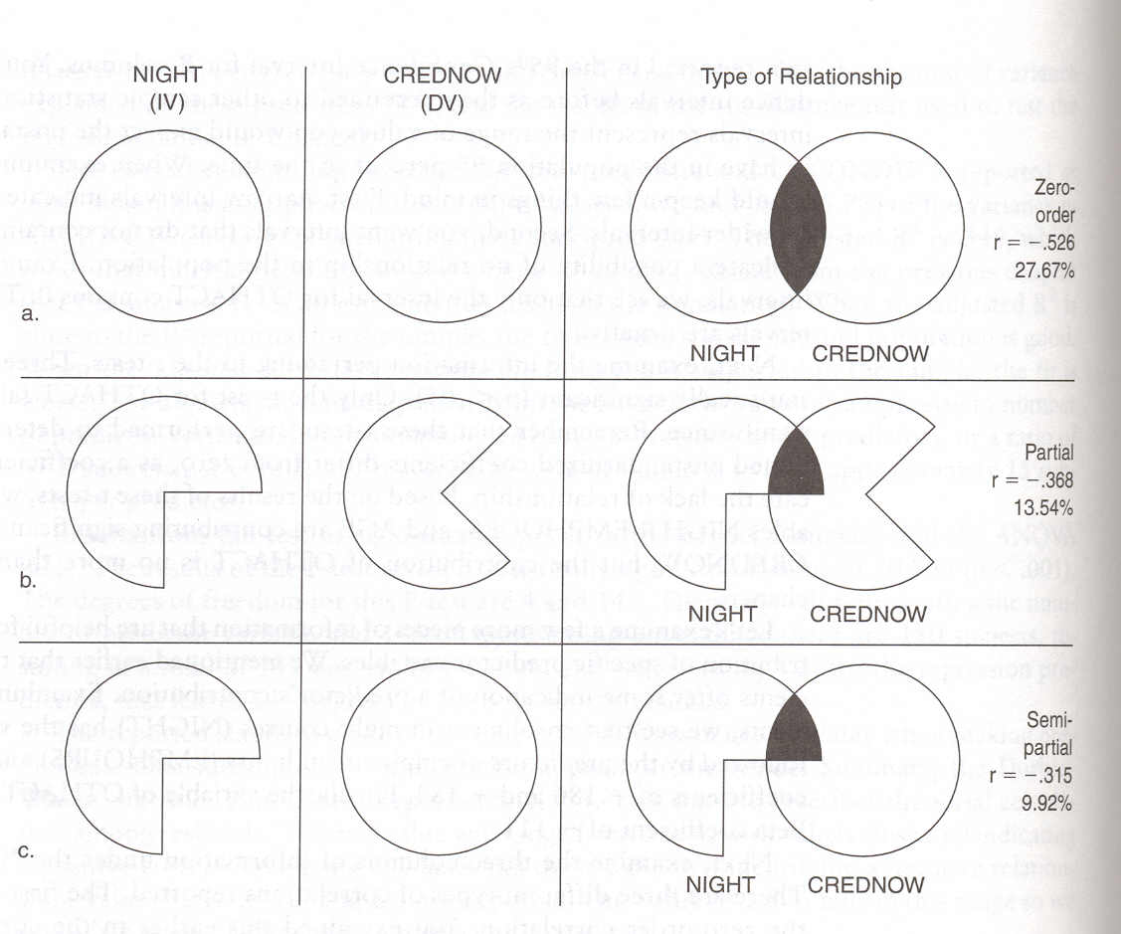
Partial Correlation
Note that a zero-order correlation is the simple (one-predictor) correlation
Partial Correlations ‘controls for’ the influence of other predictors!
The shared variability between one predictor (night) and the
other predictors is removed from both the predictor and the criterion.

Slide 57
Partial Correlation
There is one more type of correlation called the SEMI-PARTIAL correlation.
In SPSS output, the semi-partial correlation is labeled as “part”
The (regular) partial correlation is labeled appropriately as “partial”

Slide 58
Partial Correlation
When do you use partial versus semi-partial?
Zero-order
Partial
Semi-partial
The partial correlation informs about the proportion of
REMAINING variance in the criterion that is explained,
i.e.,
after the other ‘explained variance’
has been removed from the criterion.

Slide 59
Partial Correlation
When do you use partial versus semi-partial?
Zero-order
Partial
Semi-partial
The semi-partial correlation informs about the proportion of
OVERALL variance in the criterion explained by this predictor,
and NOT shared by other predictors.

Slide 60
Partial Correlation
Zero-order
Partial
Semi-partial
Why will the semi-partial r-squared always be smaller
than the partial r-squared?

